Slide 1


2024 Open
Enrollment
Grand Rapids ISD 318
START >
Notes:
I-1
Welcome/greeting
Name
Company
Title/role
Client

Slide 2


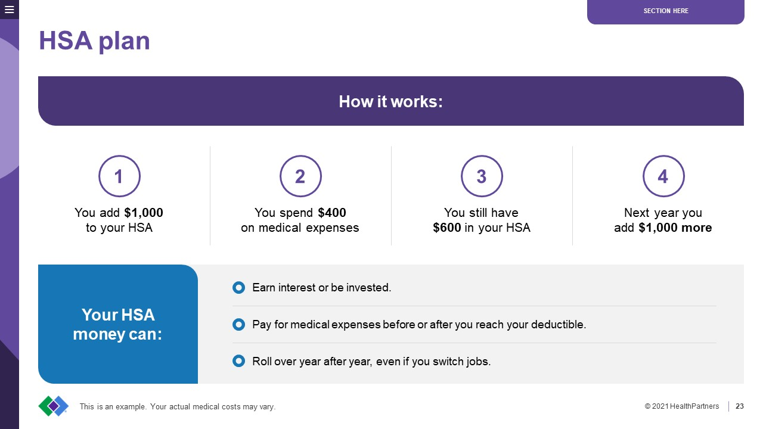
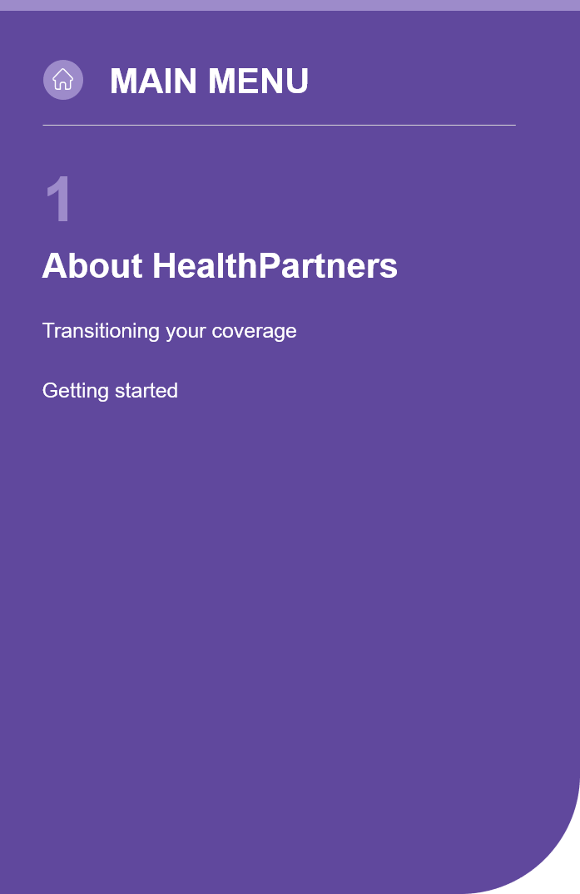
How the online learning guide works
MAIN MENU
Who is HealthPartners
Medical plan coverage and benefits
Prescription coverage
Dental plan coverage and benefits
How HealthPartners supports you
What happens next
Click anywhere on the page to go in order. Or skip to any topic, any time.
Click the 3 lines in the upper left to go ahead or back within the section.
Click MAIN MENU to view the full list of topics.
Contact us
Notes:
I-2
Hide this slide when presenting live -- Right click on the thumbnail of the slide on the left of your screen and select “Hide Slide”

Slide 3

Learn more about…
Who is HealthPartners
Medical plan coverage and benefits
Prescription coverage
Dental plan coverage and benefits
How HealthPartners supports you
What happens next
Contact us
© 2023 HealthPartners
3
Legal notices
Notes:
I-3
Outline of key points of presentation
Instructions for how to submit questions and how/when they will be answered. For example, should participants write questions in the chat function? And they’ll all be answered at the end of the of the presentation?
Instructions for how to access/view the recording, if there will be one.

Slide 4
About HealthPartners
About HealthPartners
Getting started

Slide 5


Your partner for goodSM
YOUR
MAIN MENU
About HealthPartners
About HealthPartners
Getting started
We're 26,000 partners strong, working together to support your health every day.
For you, it’s a top-rated Member Services team – here to help you understand your plan and answer your questions. It’s a plan you can trust, benefits that benefit you, and a commitment to lower costs.
We’re your partner for all of it.
Your partner for good.
Contact us
© 2023 HealthPartners
5
Notes:
A-2
HealthPartners is more than a health insurance company. We’re 26,000 people devoted to caring for you the same way we’d care for our closest friends and family. HealthPartners health insurance plans, health care system and research institution are focused on making health care simpler and more affordable for our community. We value each of our 1.8 million members and 1.2 million patients as part of that community.
HealthPartners has more than 60 years of experience supporting members with their care and coverage. We’re honored to partner with you on your health. And we’re proud that our members have recognized us for our exceptional customer satisfaction with repeated top ratings from the National Committee for Quality Assurance (NCQA), Consumer Assessment of Healthcare Providers & Systems (CAHPS) and Healthcare Effectiveness Data and Information Set (HEDIS).
We’re headquartered in Minnesota and provide nationwide medical, dental and pharmacy coverage through our work with Cigna.

Slide 6






5 tips to get started
MAIN MENU
About HealthPartners
About HealthPartners
Getting started
1
Understand your costs
2
Know what’s covered
Your online account gives you access to
updated personal health plan information
in one simple place.
From here, you can:
  See claims and how much you could owe.
  Search for doctors in your network.
  Check your out-of-pocket maximum spending.
  View your member ID card.
  Get cost estimates for care.
  Manage your health on the go with the myHP mobile app.
Your online account gives you access to
updated personal health plan information
in one simple place.
From here, you can:
  See claims and how much you could owe.
  Search for doctors in your network.
  Check your out-of-pocket maximum spending.
  View your member ID card.
  Get cost estimates for care.
  Compare prescription costs.
  Manage your health on the go with the myHP mobile app.
Your online account gives you access to
updated personal health plan information
in one simple place.
From here, you can:
  See claims and how much you could owe.
  Search for doctors in your network.
  Check your deductible or out-of-pocket maximum spending.
  View your member ID card.
  Get cost estimates for care.
  Manage your health on the go with the myHP mobile app.
Your online account gives you access to
updated personal health plan information
in one simple place.
From here, you can:
  See claims and how much you could owe.
  Search for doctors in your network.
  Check your deductible or out-of-pocket maximum spending.
  View your member ID card.
  Get cost estimates for care.
  Compare prescription costs.
  Manage your health on the go with the myHP mobile app.
Knowing your plan will help you avoid
unexpected charges.
These terms will come up throughout the year:
  Premium – how much you pay for your plan, usually taken out of your paycheck.
  Deductible – the amount you’re responsible to pay for care before your plan helps cover costs, not including your premium.
  Copay – a set amount you pay each time you visit the doctor or get a prescription.
  Coinsurance – a percent of the bill you pay. Your plan covers the rest.
  Out-of-pocket maximum – the most you’ll pay for covered care each year.
  Summary of Benefits and Coverage (SBC) – lists out the specific benefit costs for your plan.
Learn more about health plan terms.
Knowing your plan will help you avoid
unexpected charges.
These terms will come up throughout the year:
  Premium – how much you pay for your plan, usually taken out of your paycheck.
  Deductible – the amount you’re responsible to pay for care before your plan helps cover costs, not including your premium.
  Out-of-pocket maximum – the most you’ll pay for covered care each year.
  Summary of Benefits and Coverage (SBC) – lists out the specific benefit costs for your plan.
Learn more about health plan terms.
Knowing your plan will help you avoid
unexpected charges.
These terms will come up throughout the year:
  Premium – how much you pay for your plan, usually taken out of your paycheck.
  Deductible – the amount you’re responsible to pay for care before your plan helps cover costs, not including your premium.
  Copay – a set amount you pay each time you visit the doctor.
  Coinsurance – a percent of the bill you pay. Your plan covers the rest.
  Out-of-pocket maximum – the most you’ll pay for covered care each year.
  Summary of Benefits and Coverage (SBC) – lists out the specific benefit costs for your plan.
Learn more about health plan terms.
Knowing your plan will help you avoid
unexpected charges.
These terms will come up throughout the year:
  Premium – how much you pay for your plan, usually taken out of your paycheck.
  Deductible – the amount you’re responsible to pay for care before your plan helps cover costs, not including your premium.
  Copay – a set amount you pay each time you visit the doctor or get a prescription.
  Coinsurance – a percent of the bill you pay. Your plan covers the rest.
  Out-of-pocket maximum – the most you’ll pay for covered care each year.
  Summary of Benefits and Coverage (SBC) – lists out the specific benefit costs for your plan.
Learn more about health plan terms.
Knowing your plan will help you avoid
unexpected charges.
These terms will come up throughout the year:
  Premium – how much you pay for your plan, usually taken out of your paycheck.
  Copay – a set amount you pay each time you visit the doctor.
  Coinsurance – a percent of the bill you pay. Your plan covers the rest.
  Out-of-pocket maximum – the most you’ll pay for covered care each year.
  Summary of Benefits and Coverage (SBC) – lists out the specific benefit costs for your plan.
Learn more about health plan terms.
Knowing your plan will help you avoid
unexpected charges.
These terms will come up throughout the year:
  Premium – how much you pay for your plan, usually taken out of your paycheck.
  Copay – a set amount you pay each time you visit the doctor or get a prescription.
  Coinsurance – a percent of the bill you pay. Your plan covers the rest.
  Out-of-pocket maximum – the most you’ll pay for covered care each year.
  Summary of Benefits and Coverage (SBC) – lists out the specific benefit costs for your plan.
Learn more about health plan terms.
Knowing your plan will help you avoid
unexpected charges.
These terms will come up throughout the year:
  Premium – how much you pay for your plan, usually taken out of your paycheck.
  Copay – a set amount you pay each time you visit the doctor.
  Out-of-pocket maximum – the most you’ll pay for covered care each year.
  Summary of Benefits and Coverage (SBC) – lists out the specific benefit costs for your plan.
Learn more about health plan terms.
Knowing your plan will help you avoid
unexpected charges.
These terms will come up throughout the year:
  Premium – how much you pay for your plan, usually taken out of your paycheck.
  Copay – a set amount you pay each time you visit the doctor or get a prescription.
  Out-of-pocket maximum – the most you’ll pay for covered care each year.
  Summary of Benefits and Coverage (SBC) – lists out the specific benefit costs for your plan.
Learn more about health plan terms.
Knowing your plan will help you avoid
unexpected charges.
These terms will come up throughout the year:
  Premium – how much you pay for your plan, usually taken out of your paycheck.
  Deductible – the amount you’re responsible to pay for care before your plan helps cover costs, not including your premium.
  Copay – a set amount you pay each time you visit the doctor.
  Coinsurance – a percent of the bill you pay. Your plan covers the rest.
  Out-of-pocket maximum – the most you’ll pay for covered care each year.
  Summary of Benefits and Coverage (SBC) – lists out the specific benefit costs for your plan.
Learn more about health plan terms.
If a service is covered, your health plan will pay for some or all of the cost.
Your online account allows you to check the coverage and the amount you have to pay before you make an appointment.
Use these tools to learn what’s covered by your health plan:
  Summary of Benefits and Coverage
  Doctor search tool
  Chat with a Member Services representative
3
Check the extras
Your health plan does more than just process claims.
Learn about the services, resources and discounts you have available to help you live your best life.
We can help you make choices you’ll feel good about.
Contact us with questions.
4
Use your online account
5
BACK
BACK
BACK
BACK
Call Member Services
BACK
Contact us
Notes:
A-6
The more you know about your plan, the easier it is to make good decisions for your health and wallet. We’re happy you’re trusting HealthPartners. Here are some tips.
Understand your costs
You’ll likely see these terms during enrollment and throughout the year. Knowing how these costs work with your plan will help you avoid unexpected charges.
Premium – how much you pay for your plan, usually taken out of your paycheck.
Deductible – the amount you’re responsible to pay for care before your plan helps cover costs, not including your premium.
Copay – a set amount you pay each time you visit the doctor or get a prescription.
Coinsurance – a percent of the bill you pay. Your plan covers the rest.
Out-of-pocket maximum – the most you’ll pay for covered care each year.
Summary of Benefits and Coverage (SBC) – lists out the specific benefit costs for your plan.
Visit healthpartners.com/hp/insurance/glossary to learn more about health plan terms.
Know what’s covered
If a service is covered, it means your health plan will pay for some or all of the cost. Every plan is different. Your online account allows you to check that your care is covered – and the amount you’ll pay – before you make an appointment. Use these tools to learn what’s covered by your health plan:
Your Summary of Benefits and Coverage
Your doctor search tool
Your list of covered drugs
Chat with a Member Services representative
Check out your extras
Your health plan does more than just process claims. Learn more about some of the services, resources and discounts you have available to help you live your best life.
Use your online account
With an online account, you can get up-to-date personal health plan information in one simple place. You can:
See claims and how much you could owe.
Search for doctors in your network.
Check your deductible or out-of-pocket maximum spending.
View your member ID card.
Get cost estimates for care.
Compare prescription costs.
Manage your health on the go with the myHP mobile app.
We can help you make choices you'll feel good about.
Call us with questions at 952-883-5000 or 800-883-2177
Sign in or create an account at healthpartners.com

Slide 7
Medical plan
HSA plan
HSA-eligible medical expenses
How your HSA plan works
Copay/Coinsurance plan
Open Access network
Preventive care
Virtuwell – 24/7 online clinic
Doctor On Demand – virtual care
Teladoc – virtual care

Slide 8


HSA plan
MAIN MENU
Medical plan
HSA plan
HSA-eligible medical expenses
How your HSA plan works
Copay/Coinsurance plan
Open Access network
Preventive care
Virtuwell – 24/7 online clinic
Doctor On Demand – virtual care
Teladoc – virtual care
Stash away some of the money you’re saving on premiums into a
health savings account (HSA) before taxes are taken out.
Then save, invest or use it to pay for care. Figure out how much to put in this year by adding up what you spent on health care expenses last year.
Out-of-pocket maximum
Lower
premium
HSA
Deductible
Coinsurance
SAVE
USE TO PAY FOR CARE
The amount that comes out of your paycheck to pay for your insurance.
A special tax-free savings account for medical expenses.
What you pay before your plan kicks in.
Ex: Full cost
for doctor visits,
X-rays or
hospital stays
A percentage of
the bill you pay.
Ex: 20% of costs
An out-of-pocket maximum limits your costs. Once you hit the max, your health plan pays for all in-network care.
Contact us
This is an example. Your actual medical costs may vary.
Notes:
M-4
A health savings account (HSA) can help cover your medical costs throughout the year using pretax money.
What you’ll pay:
Deductible, then coinsurance
This plan has a deductible. That’s a set amount you pay before your plan helps you cover costs.
After you reach your deductible, you may pay coinsurance, which is a percent of the bill.
Out-of-pocket maximum
An out-of-pocket maximum puts a limit on what you pay during the year. Once you reach the max, your health plan pays for all in-network care.
EmpowerSM HSA plan highlights
This plan allows you to contribute money to an HSA – on your own or through direct deposit. You can determine what to put into this account by adding up what you spent on health care expenses last year to get an idea of how much to put in next year.
TIP: Put some of the money you’re saving on premiums into your HSA before taxes are taken out.

Slide 9






HSA plan
MAIN MENU
Medical plan
HSA plan
HSA-eligible medical expenses
How your HSA plan works
Copay/Coinsurance plan
Open Access network
Preventive care
Virtuwell – 24/7 online clinic
Doctor On Demand – virtual care
Teladoc – virtual care
Save or spend on eligible medical expenses, like:
Doctor visits and lab fees
Prescription and some over-the-counter meds
Dental care and braces
Vision care and LASIK surgery
Contact us
Medical equipment you use at home
© 2023 HealthPartners
9
Notes:
M-8
You can use your HSA to pay for things like:
Doctor visits and lab fees
Prescription and select over-the-counter medicines
Dental care and braces
Vision care and LASIK surgery

Slide 10
HSA plan
MAIN MENU
Medical plan
HSA plan
HSA-eligible medical expenses
How your HSA plan works
Copay/Coinsurance plan
Open Access network
Preventive care
Virtuwell – 24/7 online clinic
Doctor On Demand – virtual care
Teladoc – virtual care
How it works:
1
2
3
4
You add $1,000
to your HSA
You spend $400
on medical expenses
You still have
$600 in your HSA
Next year you
add $1,000 more
Your HSA money can:
Earn interest or be invested
Pay for medical expenses before or after you reach your deductible
Roll over year after year, even if you switch jobs
Contact us
This is an example. Your actual medical costs may vary.
Notes:
M-9
Your HSA money can:
Earn interest or be invested
Pay for medical expenses before or after you reach your deductible
Roll over year after year, even if you switch jobs

Slide 11
Copay/Coinsurance plan
MAIN MENU
Medical plan
HSA plan
HSA-eligible medical expenses
How your HSA plan works
Copay/Coinsurance plan
Open Access network
Preventive care
Virtuwell – 24/7 online clinic
Doctor On Demand – virtual care
Teladoc – virtual care
This plan gives you the predictability of a copay on most services.
Your copays are listed on your member ID card.
Copay
Coinsurance
Out-of-pocket maximum
A set amount of money.
Ex: $20 for clinic visits
(more for urgent care or ER)
A percentage of the bill you pay.
Ex. 20% of MRI costs
An out-of-pocket maximum limits your costs. Once you hit the max, your health plan pays for all in-network care.
Contact us
This is an example. Your actual medical costs may vary.
Notes:
M-13
This plan gives you the predictability of a copay on most services.
What you’ll pay
Copay
A copay is a set amount you pay when you visit the doctor or pick up a prescription. The amount depends on where you get care – like at a clinic, urgent care or the ER.
Coinsurance
You might have to pay a portion of services that aren’t covered with a copay. This is called coinsurance. For example, you might pay 20% of the cost of an MRI and your plan would cover the remaining 80%.
Out-of-pocket maximum
This puts a cap on what you have to pay during the year. Once you reach that limit, all in-network care is paid for by your health plan.
Plan highlights
You won't be surprised by how much you’ll pay. Your copays are listed on your member ID card.

Slide 12




Open Access network
MAIN MENU
Medical plan
HSA plan
HSA-eligible medical expenses
How your HSA plan works
Copay/Coinsurance plan
Open Access network
Preventive care
Virtuwell – 24/7 online clinic
Doctor On Demand – virtual care
Teladoc – virtual care
Get the most choices of doctors and clinics.
You’re here
Search the network for your doctor or find a new one at healthpartners.com/openaccess
Contact us
Notes:
M-24
Choose from the biggest network of doctors and clinics. Check for your doctor or find a new one at healthpartners.com/openaccess.

Slide 13
Care today for a healthy tomorrow
MAIN MENU
Medical plan
HSA plan
HSA-eligible medical expenses
How your HSA plan works
Copay/Coinsurance plan
Open Access network
Preventive care
Virtuwell – 24/7 online clinic
Doctor On Demand – virtual care
Teladoc – virtual care
Prevent problems
before they start.
Even if you’re not sick, you can catch any issues early – when treatment is most effective. Your health plan covers in-network preventive care at 100%; you don’t pay anything.
Alcohol, tobacco and weight screenings
Screenings for high blood pressure, diabetes and cholesterol
Breast, cervical and colorectal cancer screenings
Routine pre- and post-natal care
Vaccines
Well-child visits
Visit healthpartners.com/preventive to find out what care is recommended for you.
Contact us
Notes:
M-46
Prevent problems before they start so you can enjoy the things you love. Your health plan covers in-network preventive care at 100%; you don't pay anything.
Protect your health with routine visits
Even if you’re not sick, it’s smart to go in for regular checkups and screenings. If there are any issues, you can catch them early – when treatment is most effective.
Preventive care includes:
Alcohol, tobacco and weight screenings
Blood pressure, diabetes and cholesterol tests
Colorectal, breast and cervical cancer screenings
Routine pre- and post-natal care
Vaccines
Well-child visits
And more!
Visit healthpartners.com/preventive to find out what care is recommended for you.

Slide 14
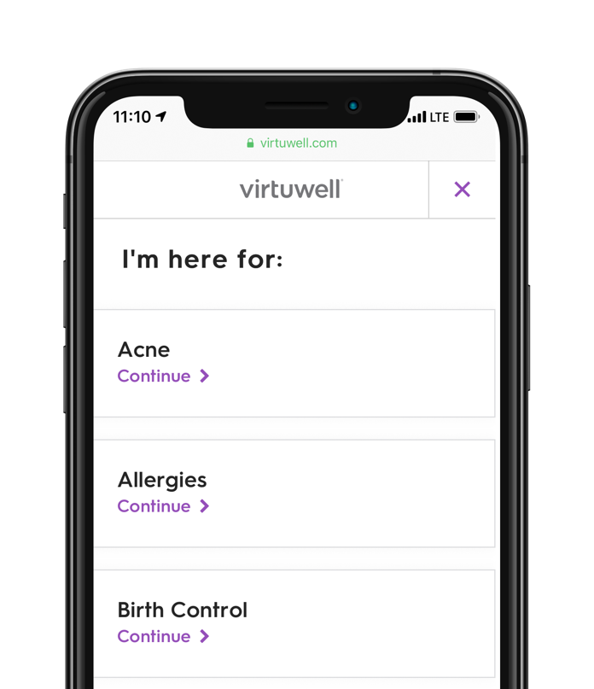
Virtuwell® – 24/7 online clinic
MAIN MENU
Medical plan
HSA plan
HSA-eligible medical expenses
How your HSA plan works
Copay/Coinsurance plan
Open Access network
Preventive care
Virtuwell – 24/7 online clinic
Doctor On Demand – virtual care
Teladoc – virtual care
Save time and money by getting treated for common conditions from your smartphone, tablet or computer. Your plan covers telemedicine care.
Fast, affordable and guaranteed
Start your visit any time with any device – no appointments, video or downloads needed
Answer a few questions online to get treatment for more than 60 common conditions
Nurse practitioners give you a diagnosis, treatment plan and prescription – all in about an hour
If for any reason you can't be treated, there's no charge. Plus follow-up care about your treatment is free
Virtuwell visits are a fraction of the cost of walk-in, urgent or primary care visits. Use your member ID card to find your cost, view FAQs and get started at virtuwell.com/cost/healthpartners
Contact us
© 2023 HealthPartners
14
Notes:
M-51
Save time and money by getting treated right from your smartphone, tablet or computer. Your plan covers telemedicine care.
Virtuwell – Your 24/7 online clinic
Get better faster. Start your visit any time with any device – no appointments, video or downloads needed. Answer a few questions online to get treatment for more than 60 common conditions. Nurse practitioners give you a diagnosis, treatment plan and prescription – all in about an hour. If for any reason you can't be treated, there's no charge. Plus follow-up calls about your treatment are free.
Use your member ID to find your cost, view FAQs and get started at virtuwell.com/cost/healthpartners.

Slide 15
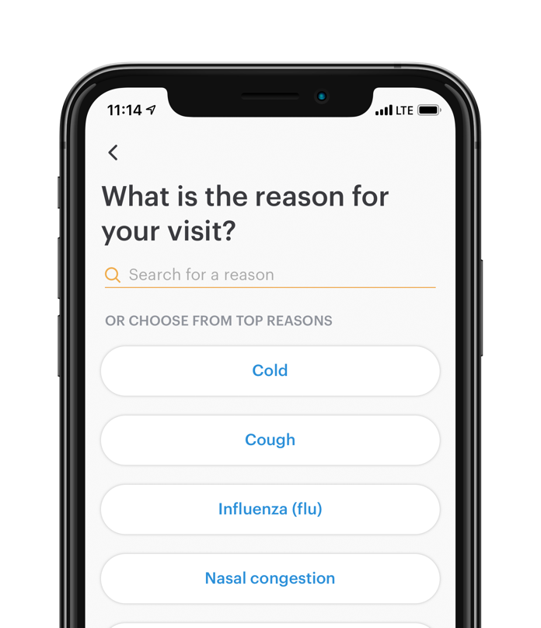
Doctor On Demand
MAIN MENU
Medical plan
HSA plan
HSA-eligible medical expenses
How your HSA plan works
Copay/Coinsurance plan
Open Access network
Preventive care
Virtuwell – 24/7 online clinic
Doctor On Demand – virtual care
Teladoc – virtual care
Save time and money by getting treated for common conditions from your smartphone, tablet or computer. Your plan covers telemedicine care.
Urgent care for cold and flu, skin conditions and allergies
Live video visits with a doctor include assessment, diagnosis and prescription
When you create a free member account, your cost is always shown up front, without any surprise bills later
Register at doctorondemand.com
Contact us
© 2023 HealthPartners
15
Notes:
M-52
Save time and money by getting treated right from your smartphone, tablet or computer. Your plan covers telemedicine care.
Doctor On Demand
Live video visits with a doctor include assessment, diagnosis and prescriptions, plus urgent care for cold and flu, skin conditions and allergies. When you create a free member account, your cost is always shown up front, without any surprise bills later. Register at doctorondemand.com.

Slide 16
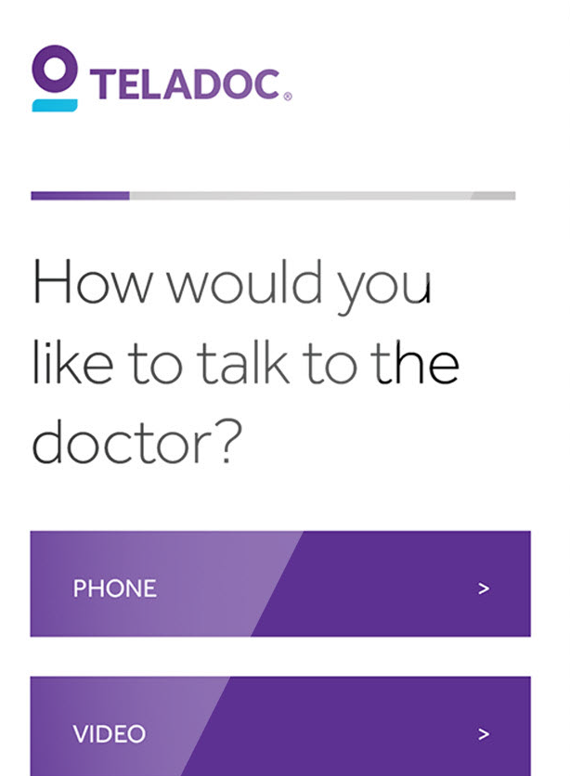
Teladoc
MAIN MENU
Medical plan
HSA plan
HSA-eligible medical expenses
How your HSA plan works
Copay/Coinsurance plan
Open Access network
Preventive care
Virtuwell – 24/7 online clinic
Doctor On Demand – virtual care
Teladoc – virtual care
Save time and money by getting treated for common conditions from your smartphone, tablet or computer. Your plan covers telemedicine care.
Fill out a brief medical history
Connect with medical experts by phone, video or mobile app
Get help whether it’s a prescription sent to the pharmacy of your choice, guidance on next steps or a review of a preexisting condition
Get started at teladoc.com
Contact us
© 2023 HealthPartners
16
Notes:
M-62
Save time and money by getting treated right from your smartphone, tablet or computer. Your plan covers telemedicine care.
Teladoc
Fill out a brief medical history to connect with medical experts by phone, video or mobile app. Whether it’s a prescription sent to the pharmacy of your choice, guidance on next steps or a review of a preexisting condition, they’re ready to help. Get started at teladoc.com.

Slide 17
Prescription benefits
Drug list
Plan resources
Rx shopping tool video
Mail order pharmacy

Slide 18
Prescription coverage
MAIN MENU
Prescription benefits
Drug list
Plan resources
Rx shopping tool video
Mail order pharmacy
Check your formulary (drug list) to understand your costs and
get support if your medicine isn’t working for you.
F$
F$$
Formulary
Covered medications on your plan’s drug list, including brand, high-cost generics, low-cost generics, and specialty medications.
NF
Non-Formulary
Medications not found on your plan’s drug list. May be covered with prior approval,
but cost more.
F$$$
Search by the name or type of medicine at healthpartners.com/preferredrx
Use your Summary of Benefits and Coverage (SBC) to find how much you’ll pay.
Contact us
Notes:
P-2
Knowing what you’ll pay for your medicine is important. Use these tools and resources to understand your costs and get support if your medicine isn’t working for you.
Check your formulary
A formulary, also called a drug list, tells you what medicines are covered by your health plan and generally how much you’ll pay. You’ll also learn if there are any requirements before you can start a medicine.
Your formulary is called PreferredRx.
Go to healthpartners.com/preferredrx.
Search by the name or type of medicine.
Use your Summary of Benefits and Coverage (SBC) in your enrollment materials to understand how each type of medicine is covered.

Slide 19




Get the most from your medicines
MAIN MENU
Prescription benefits
Drug list
Plan resources
Rx shopping tool video
Mail order pharmacy
Try generics
Search for the
lowest cost
Our online Prescription shopping tool helps you understand your plan coverage,
compare pharmacy prices, transfer prescriptions and more.
Members can get started at healthpartners.com/pharmacy
Answers to your questions around benefits, coverage, costs, formularies and more.
Call Member Services and ask to talk with a Pharmacy Navigator.
In a one-on-one visit, a pharmacist will review your medicines with you to make sure they’re working and are right for you. Plus, it’s free.
Learn more at healthpartners.com/mtminfo
Talk with a
pharmacy navigator
They’re just as safe and effective,
but cost a lot less.
Talk to your doctor or pharmacist.
Meet with a pharmacist
BACK
BACK
BACK
BACK
Contact us
Notes:
P-3
Try generics
Generics are just as safe and effective as brand-name medicines, but they cost a lot less. Save money by talking to your doctor or pharmacist about switching to a generic medicine.
Search for the lowest cost
Shopping for the lowest price medicine is easier than comparing prices for airline travel. You can use the Prescription shopping tool to:
Find the lowest cost for your medicine
Compare current prices at pharmacies near you
Understand what medicines are covered by your health plan
Transfer prescriptions to the lowest cost pharmacy
Know if you have available refills
See if you have a prior authorization and when it expires
Download tax reports of what you spent last year
Members can get started at healthpartners.com/pharmacy.
Talk with a pharmacy navigator
One call will give you answers to your questions around benefits, coverage, costs, formularies and more. Call Member Services at the number on the back of your member ID card. Ask to talk with a pharmacy navigator.
Meet with a pharmacist
In a one-on-one visit, a pharmacist will review your medicines with you to make sure they’re working and are right for you. Plus, it’s free. Visit healthpartners.com/mtminfo to learn more.

Slide 20

Manage your medications with the Rx Shopping Tool
PRESCRIPTION BENEFITS
MAIN MENU
Prescription benefits
Drug list
Plan resources
Rx shopping tool video
Mail order pharmacy
Learn more and get started at healthpartners.com/pharmacy
Contact us
Notes:
P-6 HealthPartners Prescription Shopping Tool video
Manage your medications with the Rx Shopping Tool
Your prescriptions are essential for your health. And keeping track of them should be easy.
From refills to costs, there’s a lot of information you need to know to ensure you have the medicine you need, when you need it.
With our online Prescription Shopping Tool, you can finally manage all of your prescriptions with ease.
Just sign in to see what medicines are covered by your health plan and compare local pharmacy prices so you can be confident you’re getting the best deal.
If you find a pharmacy that’s more affordable than your current one, easily switch your prescription to that new location.
And when you’re starting to run low on your medicine, check to make sure you have refills available and that your prior authorization is up to date. So you don’t ever have to go a day without your medication.
Healthcare should be straightforward. And so should managing your prescriptions.
For questions, call the Member Services number on the back of your ID card or enrollment materials and ask to speak with a Pharmacy Navigator.
Learn more and get started at healthpartners.com/pharmacy.

Slide 21

Medicine delivered to your door
PRESCRIPTION BENEFITS
MAIN MENU
Prescription benefits
Drug list
Plan resources
Rx shopping tool video
Mail order pharmacy
Skip the trip to the pharmacy. Get your prescriptions mailed to your home with WellDyne.
5 great things about mail order
1
You’ll never pay for standard shipping.
2
Refilling your medicine online or with the mobile app is easy.
3
All orders are sent in a tamper-resistant, plain package to make it
more private.
4
Safety is important. You’ll get the best quality medicine.
5
You'll get your medicine delivered within seven to 10 days and can track the status of your order every step of the way.
To get started, call 800-591-0011
or visit healthpartners.com/mailorder
Contact us
© 2023 HealthPartners
21
Notes:
P-4
Skip the trip to the pharmacy. Get your prescriptions mailed to your home with WellDyneRx.
5 great things about mail order
You’ll never pay for standard shipping.
Refilling your medicine online or with our mobile app is easy.
All orders are sent in a tamper resistant, plain package to make it more private.
Safety is important. You’ll get the best quality medicine.
You'll get your medicine delivered within seven to ten days.
TIP: You can track the status of your order every step of the way, from receipt and processing to shipping and delivery. To check the status of your order, sign into your online account or call our automated phone system.
To get started visit healthpartners.com/mailorder

Slide 22
Dental plan
Dental Open Access plan
Little Partners
MouthWise Matters

Slide 23

Dental Open Access plan
MAIN MENU
Dental plan
Dental Open Access plan
Little Partners
MouthWise Matters
A healthy mouth may help decrease the risk of diabetes, heart attacks and strokes.
That’s why our dental plans cover 100% of all in-network preventive care.
Your plan pays for some great things:
What you’ll pay:
Preventive dental services – no cost to you when you see
a network dentist
Things like getting a cavity filled might cost a
deductible – the amount you have to pay before
your plan helps with the cost
HealthPartners MouthWise Matters – extra exams and cleanings covered 100% in-network (if you’re pregnant
or have diabetes and are at risk for gum disease)
There's also coinsurance, which is a percent of the bill
You’re in charge of paying all costs after you reach the
annual maximum – the most your plan will pay
for dental care each year
The cost of other dental care at the amounts shown in
your Summary of Benefits
Contact us
Notes:
D-2
A healthy mouth may help decrease the risk of diabetes, heart attacks and strokes. That’s why our dental plans cover 100% of all in-network preventive care.
What your plan pays for
Preventive care is covered at no cost to you when you see a network dentist.
It also helps cover:
HealthPartners MouthWise Matters – extra exams, gum care and cleaning covered 100% if you’re pregnant, or if you have diabetes and are at risk of gum disease
The cost of other dental care at the amounts shown in your Summary of Benefits
What you’ll pay
Deductible or coinsurance
Things like getting a cavity filled might cost a deductible – the amount you have to pay before your plan helps with the cost.
There's also coinsurance, which is a percent of the bill.
Annual maximum
Your dental plan max is a bit different than your medical plan. It's the most your plan will pay for dental care each year. You’re in charge of the rest.

Slide 24

100% dental coverage for kids
MAIN MENU
Dental plan
Dental Open Access plan
Little Partners
MouthWise Matters
Your kids are less likely to have future dental problems when they see a dentist early.
Just add your kids to your dental plan and set up their first appointment with a network dentist.
Little PartnersSM dental benefit
for children 12 and younger:
100% coverage at an in-network dentist
Pay nothing at the dental office
No limit on dental care (excluding orthodontia)
Contact us
© 2023 HealthPartners
24
Notes:
D-22
Your kids are less likely to have future dental problems when they see a dentist early. The Little Partners dental benefit helps by covering 100% of the cost.
What’s covered
Your dental plan includes the Little Partners benefit for children 12 and under.
Get dental services covered 100% at an in-network dentist
Pay nothing at the dental office – not even a deductible or coinsurance
Relax, there’s no limit on dental care for your kids, so they can get the care they need (note that this benefit excludes orthodontia)
How it works
Just add your kids to your dental plan and set up their first appointment with a network dentist.

Slide 25

Extra dental care for your gums
MAIN MENU
Dental plan
Dental Open Access plan
Little Partners
MouthWise Matters
We share tips to keep your teeth healthy
and help you feel your best, along with important benefits.
Diabetic or pregnant and at risk of gum disease? HealthPartners MouthWise Matters covers:
100% of in-network services to help control or prevent gum disease – no coinsurance or deductible, even if you’ve hit your annual max
Extra dental checkups and cleanings
Contact us
Root planing and scaling – a deep cleaning for your teeth
© 2023 HealthPartners
25
Notes:
D-23
We share tips to keep your teeth healthy and help you feel your best. You also get important benefits, like those that help pregnant women and people with diabetes.
What it covers
If you’re living with diabetes or are pregnant and at risk of gum disease, MouthWise Matters covers:
100% of in-network services to help control or prevent gum disease
Extra dental checkups and cleanings
Root planing and scaling – a deep cleaning for your teeth
All other services, like fillings and root canals, are covered according to your Summary of Benefits.
How it works
It’s easy to get the care you need to stay healthy:
Visit a network dentist
Get 100% coverage on medically necessary gum treatment
When gum treatment is needed, there’s no coinsurance or deductible. Plus, your plan will pay even if you’ve reached your annual maximum for the year.

Slide 26
Extra support
Digital tools
Digital tools video
Living Well
Tobacco cessation
Wellbeats
Healthy Discounts
Frequent Fitness
Condition management
Emotional health
Assist America
Where to go for care

Slide 27

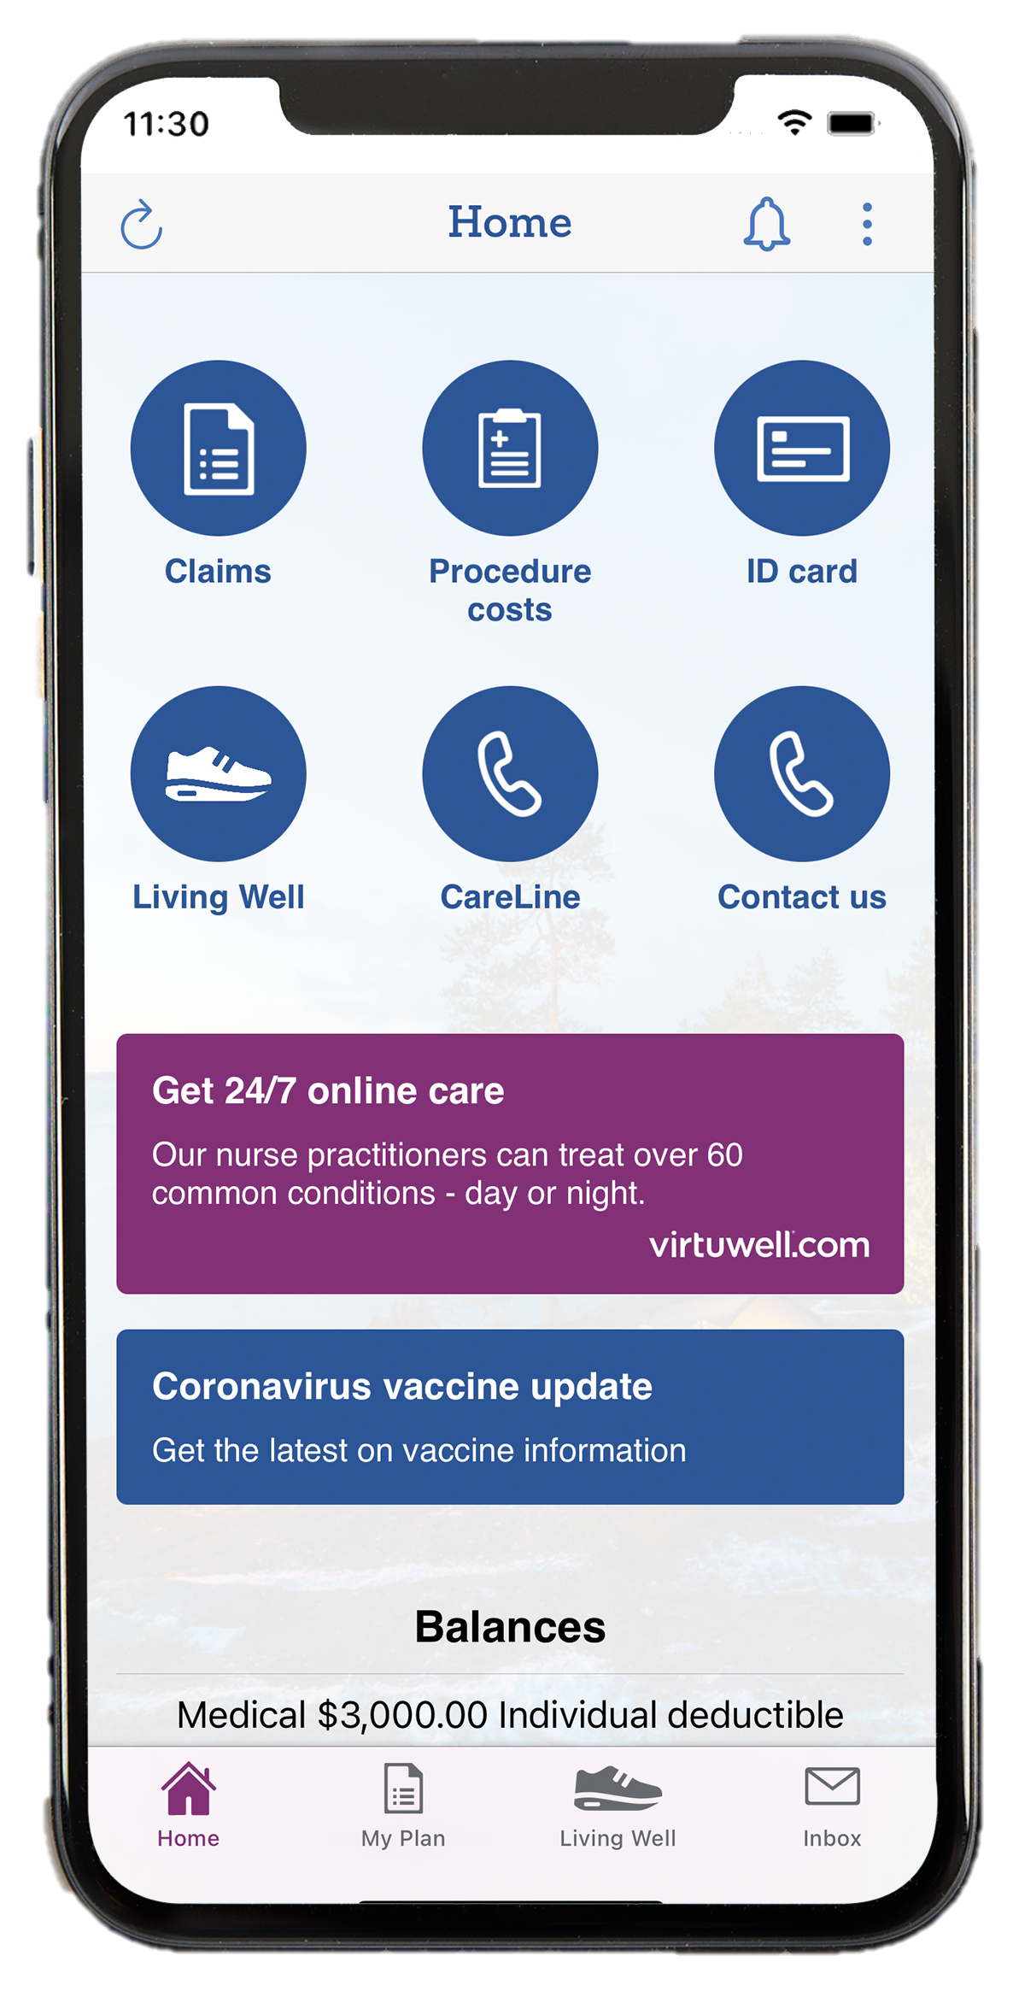
Take charge of your health plan
MAIN MENU
Extra support
Digital tools
Digital tools video
Living Well
Tobacco cessation
Wellbeats
Healthy Discounts
Frequent Fitness
Condition management
Emotional health
Assist America
Where to go for care
You go online to research, plan and follow up on big decisions.
A HealthPartners online account makes it just as easy to stay on top of your health care and insurance. You have real-time access to your personal health plan information in one simple place.
Top 6 ways to use your online account and mobile app
Access your Living Well dashboard to check your program progress, take the health assessment and complete activities.
1
1
See recent claims, what your plan
covered and how much you could owe.
4
2
3
2
Get cost estimates for treatments and procedures specific to your plan.
5
Check your balances, including the most you’ll have to pay (out-of-pocket maximum).
4
5
3
View your HealthPartners member ID
card and fax it to your doctor’s office.
6
Search for doctors and pharmacies covered by your plan.
6
Contact us
Sign in at healthpartners.com or on the myHP mobile app
Notes:
E-2
When you have a question about your plan, you have tools at your fingertips to give you the quick answers you need. A HealthPartners online account and the myHP mobile app give you real-time access to your personal health plan information in one place.
Members use their online account and mobile app to do things like searching for providers in your network, pulling up your member ID card when at the clinic, or checking your plan balances. But the #1 thing members love about their online account and mobile app is the ease of having all your plan information and documents in one place, without huge amounts of paper clutter.
Do all this and more at our website or on the myHP app.
Don't have an account yet? It's quick and easy to sign up – you'll just need your member ID card.

Slide 28

Find important plan information – in one easy place
MAIN MENU
Extra support
Digital tools
Digital tools video
Living Well
Tobacco cessation
Wellbeats
Healthy Discounts
Frequent Fitness
Condition management
Emotional health
Assist America
Where to go for care
Download the app and get connected at healthpartners.com
Contact us
Notes:
E-21 HealthPartners Web and Mobile Tools Video
With an online account and mobile app, you’ll have access to the important information you need – no matter where you are.
Signing up is simple and once you’re logged in, you can easily see your plan benefits, find nearby providers, check out cost estimates and recent claims. It’s everything you need to manage your health plan – all in one place. Download the app and get connected at healthpartners.com

Slide 29

Improve your health and well-being
MAIN MENU
Extra support
Digital tools
Digital tools video
Living Well
Tobacco cessation
Wellbeats
Healthy Discounts
Frequent Fitness
Condition management
Emotional health
Assist America
Where to go for care
It’s easy. And it’s offered at no cost to
you as a HealthPartners member.
Learn about your health by taking a confidential online health assessment
Pick a well-being activity – you’ve got lots of options
Choose what’s best for you to achieve your personal health goals
Enjoy the life you want
Sign in to your well-being program at healthpartners.com/livingwell
Contact us
CONTINUE >
© 2023 HealthPartners
29
Notes:
E-5
HealthPartners supports you in living your best life. Which is why we offer FREE programs to improve your health and well-being.
Start by taking your health assessment. You can complete the assessment online, anywhere. It takes about 15-minutes and is completely confidential. You’ll get a better picture of things you’re doing well, problem areas and what you can do to be healthier.
From there, you can pick a well-being activity that fits your goals. Want to wake up more refreshed? Bounce back from stress better? Take control of your weight? You’ve got lots of options to choose from.
We’re ready to help you take control of your health. Get started by signing in at healthpartners.com/livingwell. If this is your first time, you’ll need to create an account – have your member ID card ready.

Slide 30
Live your best life
MAIN MENU
Extra support
Digital tools
Digital tools video
Living Well
Tobacco cessation
Wellbeats
Healthy Discounts
Frequent Fitness
Condition management
Emotional health
Assist America
Where to go for care
We can help you get healthy and live better, no matter what your goals are.
Free programs and resources for HealthPartners members to:
Quit smoking
Meet other people like you
Eat better
Get your health questions answered
Manage your weight
Make sure you’re getting the right care
Save money
Make sure your medicine is working correctly
Find this support and more at healthpartners.com/livingwell
Contact us
Notes:
E-6
HealthPartners members have FREE programs and resources available to them to improve their health and live better. For example, our dieticians have crafted a variety of recipes to help you eat better, including family-friendly recipes that kids will enjoy making too.
Find free support to achieve your goals at healthpartners.com/livingwell.

Slide 31

Quit for good
MAIN MENU
Extra support
Digital tools
Digital tools video
Living Well
Tobacco cessation
Wellbeats
Healthy Discounts
Frequent Fitness
Condition management
Emotional health
Assist America
Where to go for care
Quitting tobacco and vape may be one of the hardest things you’ll ever do. You don’t have to do it alone.
Work with a health coach to set goals around tobacco use and vaping that fit your lifestyle. You’ll get support and encouragement to reach your goals and live nicotine free. Plus, you can schedule phone calls or email your health coach when it works best for you.
Beat cravings
Relieve stress
Deal with tempting social situations
Adjust to life without tobacco and vape
Sign up with a health coach at 800-311-1052.
Visit healthpartners.com/formulary to look for medicines your health plan might pay for to help you quit.
Contact us
© 2023 HealthPartners
31
Notes:
E-7
We understand how difficult it can be to stop tobacco and vape use. Our health coaches have experience fighting tough addictions. Together, you can set goals around reducing your tobacco use and vaping, that fit your life. You decide when to schedule phone calls or email your health coach. You’ll get help to work at your pace to beat cravings, relieve stress and cope with tempting situations. Your coach will give you the support and encouragement you need to reach your goals. So you can live nicotine free and feel great.
Get started by calling a health coach at the number shown. Or visit healthpartners.com/livingwell when you’re ready for more help.

Slide 32
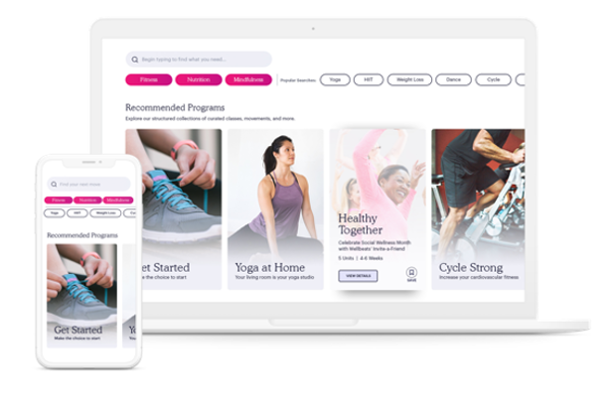
Move more with Wellbeats
MAIN MENU
Extra support
Digital tools
Digital tools video
Living Well
Tobacco cessation
Wellbeats
Healthy Discounts
Frequent Fitness
Condition management
Emotional health
Assist America
Where to go for care
Wellbeats offers on-demand fitness, nutrition and mindfulness classes to help you live a healthier life.
Find opportunities for all ages, interests and ability level.
Enjoy classes like yoga, strength training, running, meditation, nutrition and recipes, cycling, dance, stretching and more. New classes are added regularly!
Get personalized recommendations based on your well-being preferences and goals.
Sign in to your well-being program at healthpartners.com/livingwell
Contact us
Notes:
E-8
Do you love to work out with the help of a trainer or in a group fitness class? But can’t, or don’t want to, go to the gym? HealthPartners has partnered with Wellbeats to offer you FREE on-demand workouts and challenges to do when and where you like. Friendly, certified virtual trainers offer a variety of classes for every age, interest and ability. From office breaks to yoga to strength training, meditation and more. You can get personalized recommendations based on your well-being preferences and goals.
Get started signing in to your HealthPartners online account and selecting the Living Well tab. Don't have an account yet? It's quick and easy to sign up – you'll just need your member ID card.

Slide 33
Living healthier just got a little less expensive
MAIN MENU
Extra support
Digital tools
Digital tools video
Living Well
Tobacco cessation
Wellbeats
Healthy Discounts
Frequent Fitness
Condition management
Emotional health
Assist America
Where to go for care
Get special savings from handpicked retailers –
all designed to help you live healthy every day.
Discounts on gym memberships
Husk Gym Network:
Discounts on memberships at more than 11,000 fitness centers, weight loss programs and wellness brands
The Active&Fit Direct™ program:
Access more than 11,000 fitness centers nationwide for a flat monthly fee
Show your member ID card to save money on:
Eyewear
Healthy mom and baby products
Exercise equipment
Hearing aids
Fitness classes
Pet insurance
Well-being classes
And more!
Eating well
Visit healthpartners.com/discounts for a list of participating retailers and discounts
Contact us
Notes:
E-9
HealthPartners members get special savings on many products and services – all designed to help you live healthy every day.
Save money just by showing your member ID on things like eyewear, healthy eating delivery services and hearing aids. Even discounts with select pet insurance providers. So you can rest easy knowing your furry family is protected too.
We now also offer discounts through both Husk Gym Network, as well as The Active&Fit Direct program.
Husk Gym Network provides access to premier fitness, weight loss and wellness brands – at discounted pricing – as well as thousands of gyms and studios across the U.S.
The Active&Fit Direct™ program is a fitness membership program that provides access to more than 10,000 participating fitness centers nationwide.
Visit healthpartners.com/discounts to see all participating retailers and discounts.

Slide 34
Get paid to work out
MAIN MENU
Extra support
Digital tools
Digital tools video
Living Well
Tobacco cessation
Wellbeats
Healthy Discounts
Frequent Fitness
Condition management
Emotional health
Assist America
Where to go for care
1
Participating gyms* include:
Find a participating gym near you
Anytime Fitness
2
Sign up – show your member ID card at the front desk
LA Fitness
3
Life Time Fitness
Work out at least 12 times* each month
Snap Fitness
4
Save up to $20 – your gym membership account will be reimbursed six to eight weeks after your monthly workouts
And more!
Visit healthpartners.com/frequentfitness to find a gym near you
Contact us
*Not all club locations apply. Some national clubs are owned by individual franchise owners and may not participate in the program. Frequent Fitness is limited to members, age 18 years or older, of certain HealthPartners medical plans and members of participating employer groups. Some restrictions apply. Termination of club membership may result in forfeiture of any unpaid incentive. See participating club locations for program details. Workout requirements and program eligibility may vary by employer. Please check with your employer or call Member Services to verify eligibility and visits requirements. Program payments will not exceed club dues.
Notes:
E-10
You deserve a reward for working out. When you go to the gym at least 12 times each month HealthPartners can save you up to $20 on your gym membership.
To earn your discount, start by searching for your gym or finding a new one at healthpartners.com/frequentfitness.
Next, show your member ID card at the front desk when you sign up, or the next time you go in.
Make sure you work out at least 12 times each month.
Then, wait to get paid – your gym membership account will be reimbursed six to eight weeks after your monthly workouts.
If you don’t meet the 12 visit requirement one month, no problem. The discount starts over each month and you have a new chance reach the 12 visit goal each month.

Slide 35

Personal nurse support
MAIN MENU
Extra support
Digital tools
Digital tools video
Living Well
Tobacco cessation
Wellbeats
Healthy Discounts
Frequent Fitness
Condition management
Emotional health
Assist America
Where to go for care
Living with a health condition is easier when you have a team of people to support you. Work with a nurse one on one at no cost.
We offer personalized support and resources through phone calls and other communications for no cost. So you can manage your condition and stay out of the hospital.
Working with a HealthPartners nurse is a great addition to your health care team. All support is confidential. A HealthPartners nurse can help:
Focus on your goals
Answer questions
Work with you and your doctor
Connect you to resources
Get started at healthpartners.com/nursesupport
Contact us
© 2023 HealthPartners
35
Notes:
E-13
Chronic and rare health conditions like diabetes, asthma, heart disease, and rheumatoid arthritis can make tasks that used to be easy, much harder. Having a personal nurse to support you can help you manage your condition, prevent complications and stay out of the hospital.
A HealthPartners nurse is a great addition to your health care team. Through phone calls and other communications, we’ll support you in feeling your best and meeting your personal health goals. It’s all confidential and NO COST for HealthPartners members.
Your nurse will help
Answer questions and provide resources about your condition
Discuss how your treatment is going
Navigate the health system and your benefits
Work with your doctor
And more
Visit healthpartners.com/nursesupport to learn more about our condition management services or request that a nurse contact you.

Slide 36

A resilient you
MAIN MENU
Extra support
Digital tools
Digital tools video
Living Well
Tobacco cessation
Wellbeats
Healthy Discounts
Frequent Fitness
Condition management
Emotional health
Assist America
Where to go for care
We’re here to support the whole you – including your emotional health.
Our free and confidential programs will help you build resilience and cope with life’s challenges.
Digital well-being activities to help build healthy habits, like Healthy Thinking and Tackle Stress
Behavioral health navigators
Guidance to understand
your mental or chemical
health benefits
myStrength flexible and comprehensive digital program with tools and activities for stress, depression, sleep and more
Answers to benefits-related questions from
behavioral health navigators
Visit healthpartners.com/resilience for more information and resources
Contact us
Notes:
E-16
Particularly as the environment around us impacts our lives, HealthPartners is here to support the whole you, including your emotional health.
We offer confidential, NO COST programs to help you build your emotional resilience and cope with life’s challenges. For example, our Healthy Thinking and Tackle Stress well-being activities help you practice thinking positive thoughts and releasing stress in healthy ways. Or, our 4 Building Emotional Resilience courses teach you to improve your listening skills, boost your resilience at work and more. All programs give you concrete skills you can use daily.
Not only are these courses free, they’re online so you can access them whenever it works for you.
Find all of these courses at healthpartners.com/resilience.
And if you need more support, but aren’t sure how your benefits will cover your care, our Behavioral health navigators can help. Give them a call.

Slide 37

Travel anywhere, worry-free
MAIN MENU
Extra support
Digital tools
Digital tools video
Living Well
Tobacco cessation
Wellbeats
Healthy Discounts
Frequent Fitness
Condition management
Emotional health
Assist America
Where to go for care
Assist America provides all the support you need when you’re more than 100 miles from home.
Get 24/7 help with:
Coordinating transport to care facilities or back home
Pre-trip info, like immunization and visa requirements
Filling lost prescriptions
Tracking down lost luggage
Finding good doctors
Translator referrals
Getting admitted to the hospital
And more!
Download your Assist America card at healthpartners.com/getcareeverywhere
Get the Assist America app for use on-the-go, reference number 01-AA-HPT-05133
Contact us
Notes:
E-19
There’s no doubt HealthPartners supports your health here at home. But what if you’re traveling abroad or just out of town for the weekend? Thanks to Assist America, your HealthPartners plan also provides the support you need when you’re more than 100 miles from home.
Assist America is available 24/7 to help you with unexpected healthcare emergencies. They can help:
Coordinate your transport to care facilities or back home
Fill lost prescriptions
Find good doctors
Get you admitted to the hospital
They can even help with travel logistics like:
Pre-trip immunization and visa requirements
Tracking down lost luggage
Translator referrals
And more!
So add the Assist America app and ID to your packing list before you leave. Visit healthpartners.com/getcareeverywhere to get started.

Slide 38
Get the right care at the right price
MAIN MENU
When you need | Go to | Average costs | Average time spent
Health advice from a registered nurse for: • At-home remedies • When to go in for care | HealthPartners CareLine℠ nurse line 24/7 tips and advice | Free | minutes
Treatment and prescriptions for minor medical issues, like: • Bladder infection • Pink eye • Upper respiratory infections | Telemedicine or convenience care | $ | minutes
A regular checkup or special care during the day for things like: • Diabetes management • Vaccines | Primary care clinics | $$ | minutes
Care for urgent problems when your doctor’s office is closed, like: • Cuts that need stitches • Joint or muscle pain | Urgent care clinics | $$$ | minutes
Help in an emergency, such as: • Chest pain or shortness of breath • Head injury | Emergency room | $$$$ | minutes +
Extra support
Digital tools
Digital tools video
Living Well
Tobacco cessation
Wellbeats
Healthy Discounts
Frequent Fitness
Condition management
Emotional health
Assist America
Where to go for care
15
15
30
45
60
Contact us
Search the network to find an in-network option specifically covered by your plan
Notes:
E-20
It’s tempting to rush to the emergency room when conditions are rough. But your plan covers a range of options that are faster and cost less. Knowing the differences between the options can help you choose where to get the right care for the best cost.
Find in-network clinics and hospitals by signing into your online account at healthpartners.com or the myHP mobile app. Still not sure where to go? HealthPartners CareLine can help you figure out the best place based on the urgency of your care needs.

Slide 39
What’s next
ID card
Keep in touch
Notes:
N-1

Slide 40

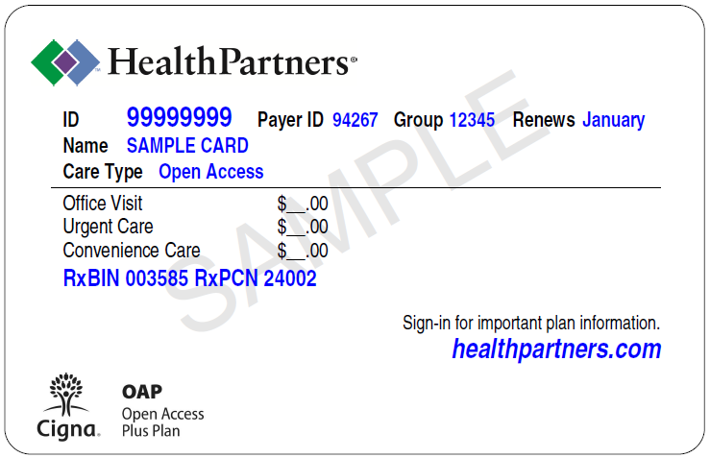
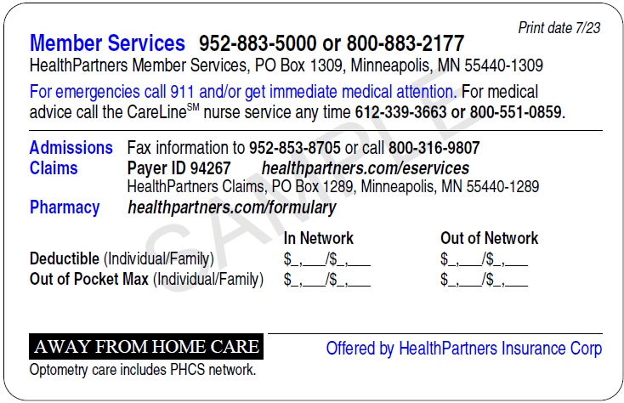
Your member ID card
MAIN MENU
What’s next
ID card
Keep in touch
For anyone enrolling in a new plan, you’ll get a new ID card.
Each person on the plan will get their own ID card. Your provider will take a copy of your card so they can
submit your claim to us. Pull it up on the go and fax it to your clinic in the myHP mobile app.
We’re here for you – easily find our number and give us a call
For your doctor to ask questions and submit claims
Contact us
National coverage with Cigna
Notes:
N-2
For anyone enrolling in a new plan, you’ll get a new ID card. Here’s a sample of what a card looks like. If you ever have questions about your plan, our Member Services number is easily listed on the back.
Your provider will take a copy of your card so they can submit your claim to us. If they aren’t familiar with HealthPartners, let them know you have national coverage through our relationship with Cigna. Or just have them call us directly.
Each person on the plan will get their own ID card. And because no one likes carrying more cards in their wallet, ID cards are also accessible on your computer or phone through your HealthPartners online account or the myHP mobile app. With the app you can even fax the card to your clinic when you check in for an appointment.

Slide 41

Let’s keep in touch
MAIN MENU
What’s next
ID card
Keep in touch
As your new plan year begins,
it’s important to stay connected.
Watch for your ID card in the mail
Create and use your online account
Get tips and reminders via email
Call us with questions
Once you have your ID card, visit healthpartners.com/signupnow to
create your online account in less than 5 minutes
Contact us
Notes:
N-6
Walking you through your open enrollment decisions and making sure you understand your health plan is just the first way we help you stay healthy. We want to stay connected all year long! If you already have a member ID card, now’s a great time to set up your HealthPartners online account and download the myHP mobile app. Visit healthpartners.com/signupnow. Not only do you get 24/7 online access to your personal plan information, we’ll also periodically send you tips and reminders about your health.
And we can’t say it enough – our Member Services team loves to help. Give us a call if you have questions about your plan or even if you just want to get to know your plan a little better.

Slide 42


Here for you 24/7
MAIN MENU
Member Services | Help with all things related to your plan | Mon – Fri, 7 a.m. to 6 p.m., CT 800-883-2177 or 952-883-5000
Nurse NavigatorSM program | Support in finding the right care | Mon – Fri, 7:30 a.m. to 5 p.m., CT 800-883-2177 or 952-883-5000
Pharmacy Navigators | Help with your medicines | Mon – Fri, 8 a.m. to 5 p.m., CT 800-883-2177 or 952-883-5000
Behavioral Health Navigators | Help with mental or chemical health benefits | Mon – Fri, 8 a.m. to 5 p.m., CT 888-638-8787
CareLineSM service nurse line | Trusted nurse advice | 24/7, 365 days a year 800-551-0859
BabyLine phone service | Expert guidance on your pregnancy or new baby | 24/7, 365 days a year 800-845-9297
Member Services | Help with all things related to your plan | Mon – Fri, 7 a.m. to 6 p.m., CT 800-883-2177 or 952-883-5000
Nurse NavigatorSM program | Support in finding the right care | Mon – Fri, 7:30 a.m. to 5 p.m., CT 800-883-2177 or 952-883-5000
Pharmacy Navigators | Help with your medicines | Mon – Fri, 8 a.m. to 5 p.m., CT 800-883-2177 or 952-883-5000
Behavioral Health Navigators | Help with mental or chemical health benefits | Mon – Fri, 8 a.m. to 5 p.m., CT 888-638-8787
CareLineSM service nurse line | Trusted nurse advice | 24/7, 365 days a year 800-551-0859
BabyLine phone service | Expert guidance on your pregnancy or new baby | 24/7, 365 days a year 800-845-9297
Member Services | Help with all things related to your plan | Mon – Fri, 7 a.m. to 6 p.m., CT 800-883-2177 or 952-883-5000
CareLineSM service nurse line | Trusted nurse advice | 24/7, 365 days a year 800-551-0859
BabyLine phone service | Expert guidance on your pregnancy or new baby | 24/7, 365 days a year 800-845-9297
Member Services | Help with all things related to your plan | Mon – Fri, 7 a.m. to 6 p.m., CT 800-883-2177 or 952-883-5000
Nurse NavigatorSM program | Support in finding the right care | Mon – Fri, 7:30 a.m. to 5 p.m., CT 800-883-2177 or 952-883-5000
Behavioral Health Navigators | Help with mental or chemical health benefits | Mon – Fri, 8 a.m. to 5 p.m., CT 888-638-8787
CareLineSM service nurse line | Trusted nurse advice | 24/7, 365 days a year 800-551-0859
BabyLine phone service | Expert guidance on your pregnancy or new baby | 24/7, 365 days a year 800-845-9297
Who is HealthPartners
Medical plan coverage and benefits
Prescription coverage
Dental plan coverage and benefits
How HealthPartners supports you
What happens next
Member Services | Help with all things related to your plan | Mon – Fri, 7 a.m. to 6 p.m., CT 800-883-2177 or 952-883-5000
Nurse NavigatorSM program | Support in finding the right care | Mon – Fri, 7:30 a.m. to 5 p.m., CT 800-883-2177 or 952-883-5000
Behavioral Health Navigators | Help with mental or chemical health benefits | Mon – Fri, 8 a.m. to 5 p.m., CT 888-638-8787
CareLineSM service nurse line | Trusted nurse advice | 24/7, 365 days a year 800-551-0859
BabyLine phone service | Expert guidance on your pregnancy or new baby | 24/7, 365 days a year 800-845-9297
< BACK
Notes:
C-1
When you need to talk to someone, we have teams ready to help.
Our top-rated Member Services team is dedicated to answering questions about all things related to your plan – whether you want to know how much your plan will cover a service, if a provider is in your network, or what a ‘network’ even is.
If you have a particularly complex need, Member Services can transfer you to staff further specialized in care coordination and guidance, such as our Nurse, Pharmacy or Behavioral Health Navigators.
And when you have a question about your health and aren’t sure where to start, our CareLine nurses will answer your call, 24 hours a day, 7 days a week. They can help you decide if you need to rush to the doctor, or if you can treat your symptoms at home, and how.
No need for you to write these numbers down now, because they’re always within reach. You can easily find the Member Services and CareLine phone numbers on your member ID card.

Slide 43



